Slide 1
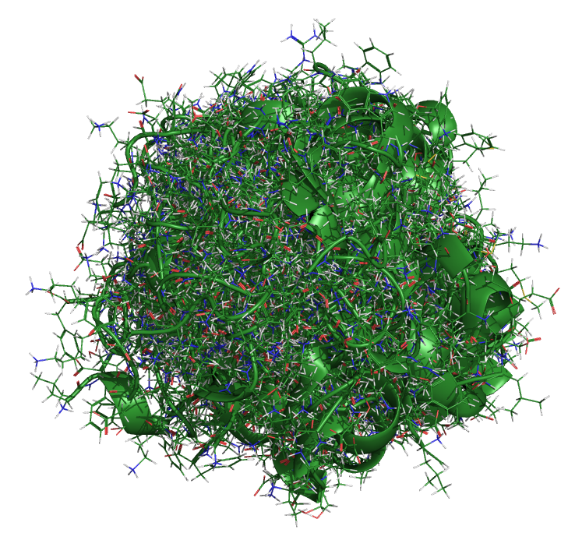
Crest and conformational searches
Heidi Klem
CAMLC 2024
Jaca, Spain

Slide 2
Core Comp. Chem. Methods
Molecular Mechanics
Semiempirical
Density Functional Theory
Ab Initio
Classical mechanics
Computationally inexpensive
Parameterized force fields
Quantum mechanics-ish
Based on Schrödinger equation
Parameterized with empirical data
Quantum mechanics-ish
Based on Schrödinger equation
Electron density rather than wavefunction
Quantum mechanics
Schrödinger equation
Approximations required
1998 Nobel Prize in Chemistry
John Pople “for his development of computational methods in quantum chemistry”
Walter Kohn “for his development of the density functional theory”
2013 Nobel Prize in Chemistry
Martin Karplus, Michael Levitt, and Arieh Warshel “for the development of multiscale models for complex chemical systems”
Notes:
Raise of hands- how many people here have used Molecular mechanics? Semiempirical methods? DFT? Ab initio?
Ab initio methods: CI, MP2, CCSD(T) = gold standard

Slide 3
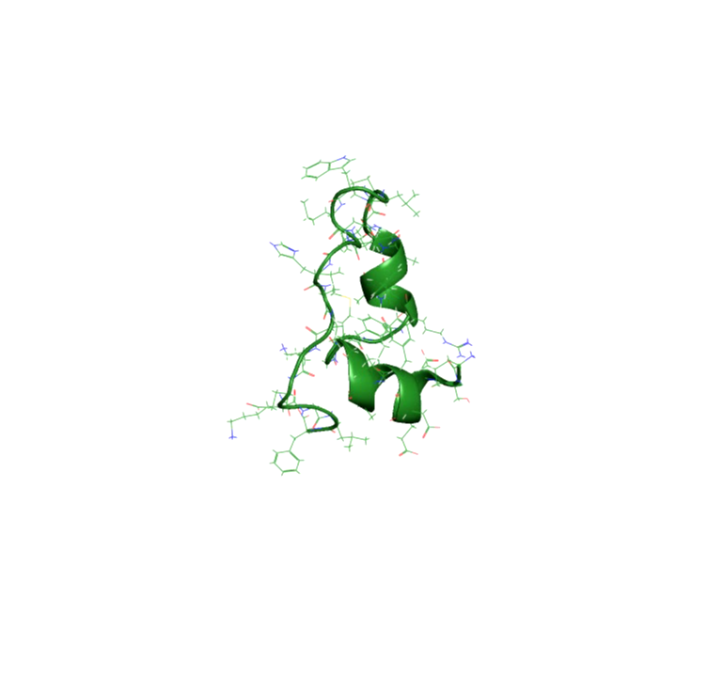
“Everything that living things do can be understood
in terms of the jiggling and wiggling of atoms”
- Richard Feynman
Snapshots from a 105 µs trajectory
Chicken villin heapiece-35 (HP35)
Simulation by D.E.Shaw Research
Notes:
Atoms are in perpetual motion (because absolute 0 in Kelvin is theoretical).

Slide 4
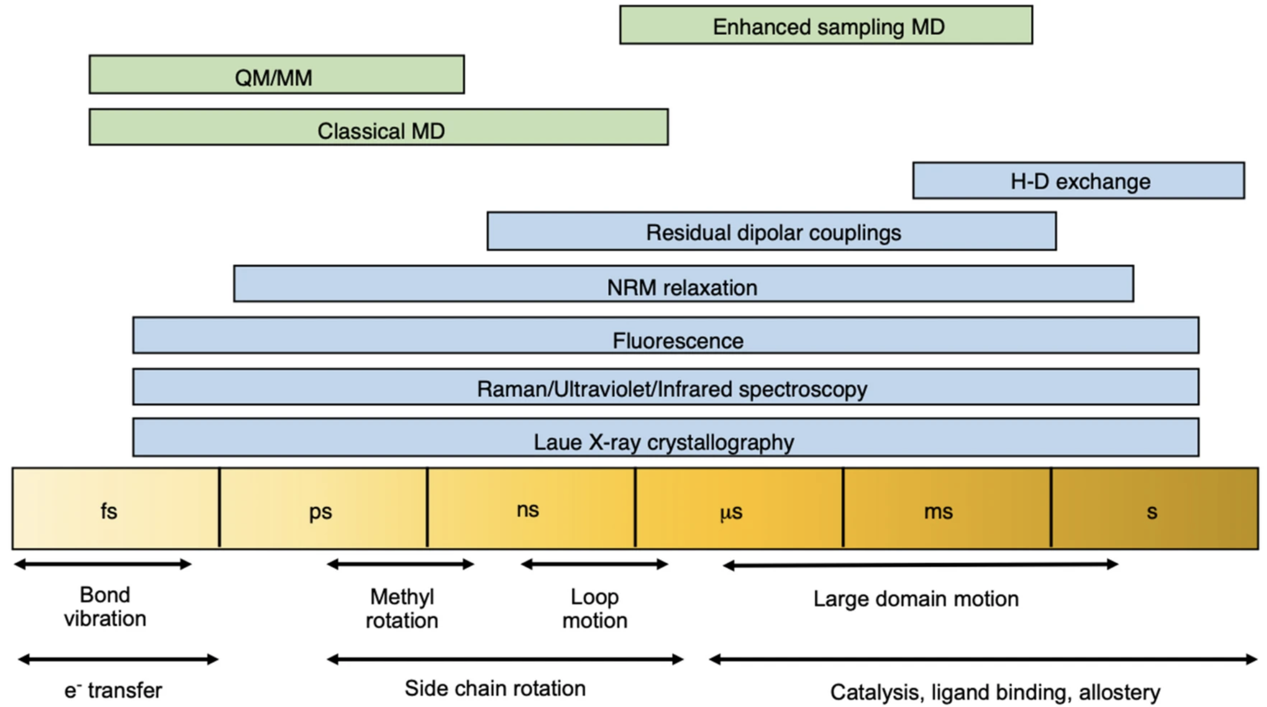
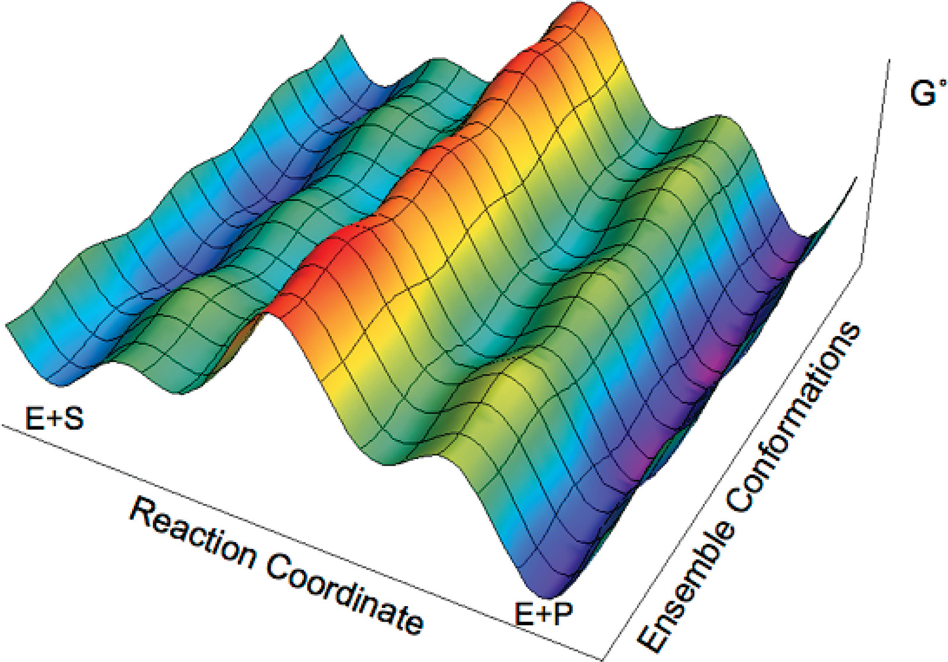
Molecular motions
Multiple populations of conformations, intermediates, and transition states can exist.
Macroscopic/bulk vs. microscopic
Notes:
Potential energy surface: describes the relationship between molecular geometry and energy
Conformational analysis is one of the central topics in computational chemistry.
All the properties of that molecule are the combination of the properties of its conformers accessible at the temperature of the study.
The ground truth about nature is demonstrated by experiment, our goal in computational chemistry is to create models that are realistic enough they agree with experiment.
Schematic representation of the standard free-energy landscape. The conformational changes occurring along the reaction coordinate axis correspond to the environmental reorganization that facilitates the chemical reaction. In contrast, the conformational changes occurring along the ensemble conformations axis represent the ensembles of configurations existing at all stages along the reaction coordinate, leading to a large number of parallel catalytic pathways. This figure illustrates the multiple populations of conformations, intermediates, and transition states. Strong coupling can occur between the reaction coordinates and the conformation ensembles; i.e., the reaction paths can slide along and between both coordinates.

Slide 5
Conformational variability in the PBD ligand. (upper) Instances A and B from PDB structure 4f9v, RMSD = 0.22 Å. (lower) Instance A from 4f9v and instance A from 3iqe, RMSD = 2.24 Å.
https://pubs.acs.org/doi/10.1021/acs.jcim.7b00221

Slide 6
Tasks
Generate conformers
Stochastic versus systematic
Analyze conformers

Slide 7
Clarifying terminology
Geometry versus Conformer
Stochastic
versus
Systematic
Notes:
A conformer is a distinct conformation (arrangement of atoms of a molecule) at a minimum on the molecule’s potential energy surface.
Searching is more general, often done in a systematic manner, not necessarily according to any laws of motion. Usually informed by the internal degrees of freedom of a molecule

Slide 8
Stochastic approaches
Molecular dynamics (time evolution of atomic positions) to explore conformational landscape
Goal is to sufficiently sample phase space to directly obtain the Boltzmann weighted conformational ensemble
represent geometric distributions that represent the experimentally relevant conformational ensemble
Applications to large molecules (well beyond 500 atoms)
Structural clustering can be used to identify and quantify stable conformations
The resulting discretized trajectory data can be used with Markov State Modeling to recover the equilibrium properties of a process.
Notes:
Dynamic properties
Non deterministic, so you don’t know a priori how long to run to sufficiently sample
roughly exponential (≈3N ) with the number of “rotatable” bonds (N). Becomes unfeasible for larger systems.

Slide 9
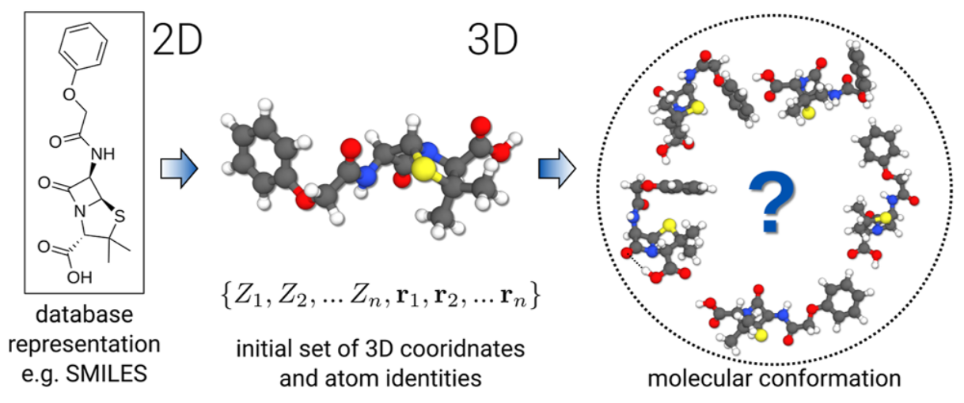
Systematic approach
Goal is to identify lowest energy conformers that represent the experimentally relevant conformational ensemble
Better suited for small molecules ( < 500 atoms) often involving iterative procedures
Calculations performed on minimized conformers and results are Boltzmann averaged
Depending on the size of the molecule, it might be possible to figure out all possible conformers
Heuristic or physics-based
https://pubs.aip.org/jcp/article/160/11/114110/3278084/CREST-A-program-for-the-exploration-of-low-energy
Notes:
Static properties- not to say snapshots cant be used to infer dynamic properties

Slide 10
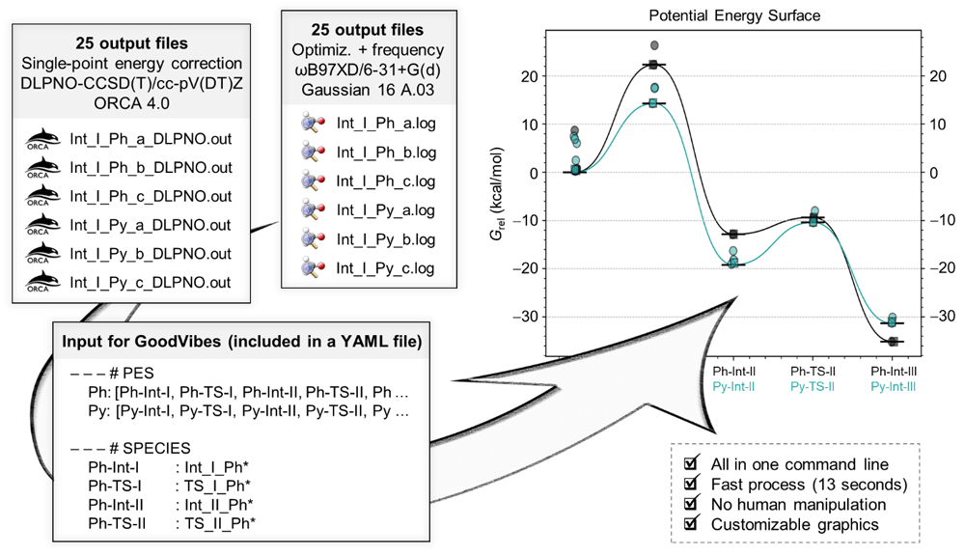
Conformational Searching
Goal is to identify lowest energy conformers that represent the experimentally relevant conformational ensemble
Better suited for small molecules ( < 500 atoms) often involving iterative procedures
Calculations performed on minimized conformers and results are Boltzmann averaged
Depending on the size of the molecule, it might be possible to figure out all possible conformers
Luchini G, Alegre-Requena JV, Funes-Ardoiz I and Paton RS. GoodVibes: automated thermochemistry for heterogeneous computational chemistry data [version 1]. F1000Research 2020, 9(Chem Inf Sci):291 (doi: 10.12688/f1000research.22758.1)
Notes:
Static properties- not to say snapshots cant be used to infer dynamic properties

Slide 11
How to model chemistry consistent with experiment? How to do this accurately and efficiently?

Slide 12
Conformational Analysis
Can be computationally demanding depending on the accuracy you seek
Intelligently designed workflows, often involving multiple optimization rounds, can reduce the computational demand
Automation can promote reproducibility and reduce headaches!

Slide 13
Conformer Optimization
ANI-1
Accurate NeurAl network engine for Molecular Energies
Deep neural network train on QM DFT calcs
Applies only to HCNO atoms
GAFF
General Amber force-field
GFN-FF
Generic polarizable force-field of the GFN family of methods
All elements up to Radon
GFN2-xTB
Geometries, Vibrational Frequencies, and Noncovalent interactions
eXtensions in the AO basis set using density functional Tight Binding methods
All elements up to Radon
Notes:
https://www.youtube.com/watch?v=db-1vz5SmYg
https://www.youtube.com/watch?v=tLyBCJ7vApQ

Slide 14
Conformational search tools
RDKit
Rotate molecule around torsion angles
Low level FF optimization
Higher level semi-empirical optimization
Pseudo code
From rdkit.Chem import AllChem as Chem
Import ase
Mol = Chem.MolFromSmiles(smi)
GetFF = Chem.UFFGetMoleculeForceField(mol)
Converged = GetFF.Minimize(maxits=1000)
Optimizer = ase.optimize.BFGS(ase_molecule)
Notes:
https://www.youtube.com/watch?v=db-1vz5SmYg

Slide 15
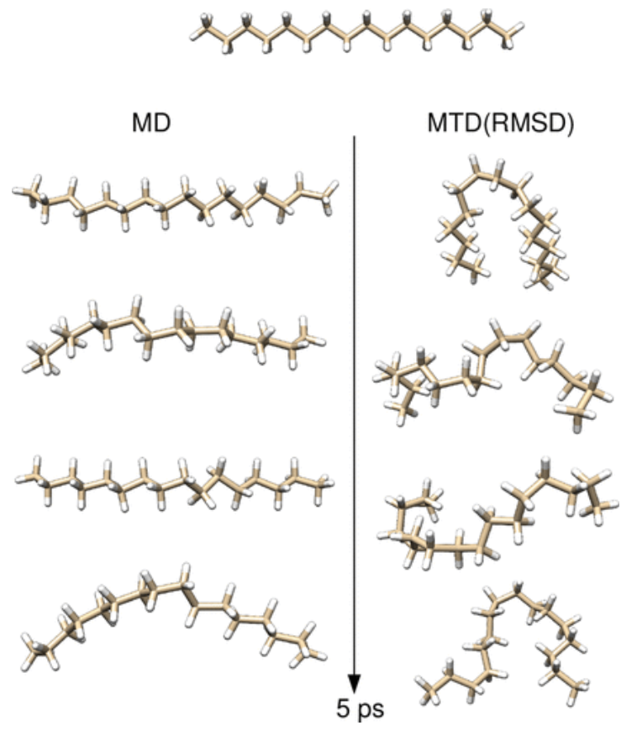
CREST-xTB
For energy calculations and geometry optimizations, CREST uses either force field or semiempirical methods.
CREST, xtb software is public, free, actively maintained
J. Chem. Theory Comput. 2019, 15, 5, 2847–2862
Phys. Chem. Chem. Phys., 2020,22, 7169-7192
Notes:
Metadynamics based on tight-binding method: J. Chem. Theory Comput. 2019, 15, 5, 2847–2862
Structures of C₁₆H₃₄ conformational snapshots in two 5 ps MTD(RMSD)/GFN2-xTB simulations with k_{i}/N = 0.002E_{h} and α = 0.8 Bohr^{–1}. The average temperature in both runs was about 440 K.

Slide 16
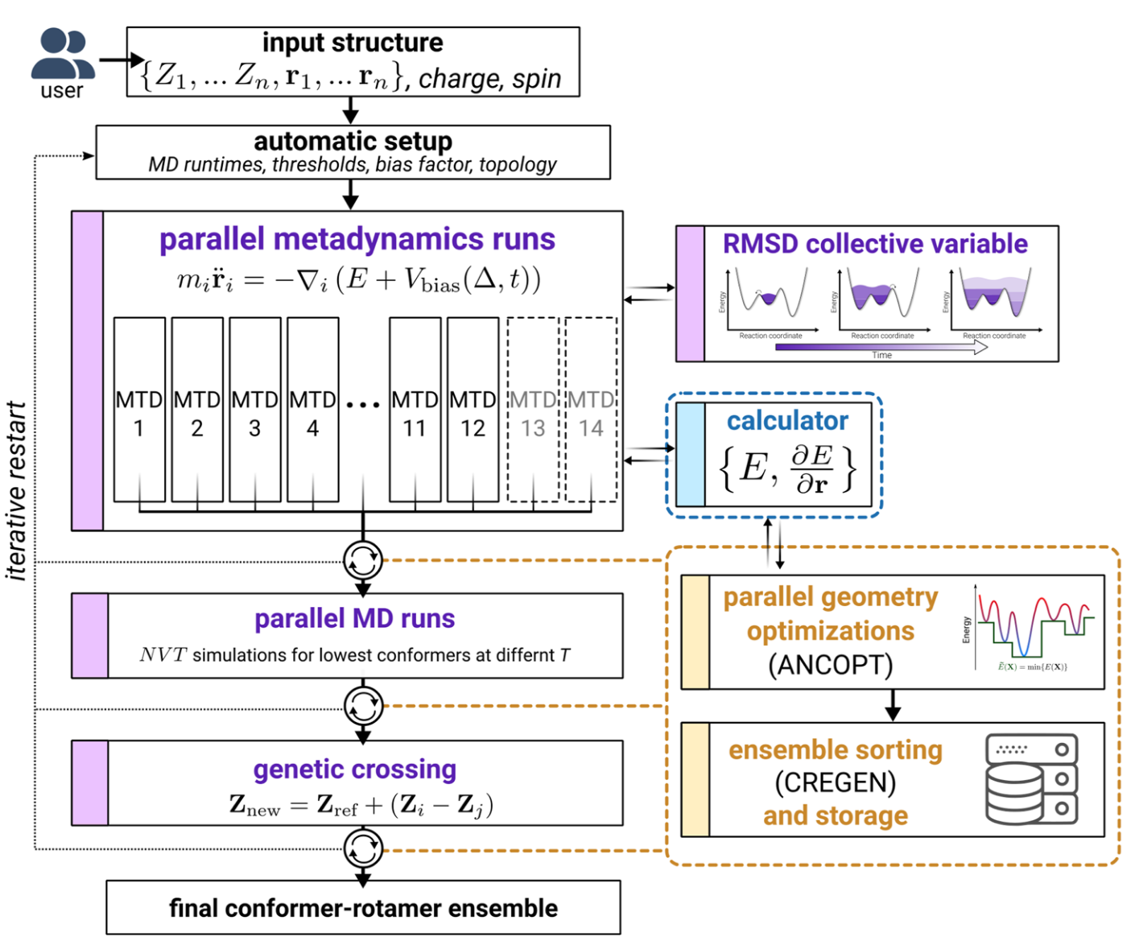
CREST iMTD-GC
Parallel runs to vary parameters in the bias potential
MTDs are well-suited to cross high-barriers, at the cost of missing some small-barrier changes
So MD runs are performed at two different temperatures on usually the lowest 4 confs found so far, to target rotamer sampling
Rotamer sampling is augmented by use of a GC algorithm to introduce “mutations”
The confs generated at each stage are reoptimized using the Approximate Normal Coordinate OPTimizer (ANCOPT) algorithm and if at any point a new lowest energy conf is found the process is restarted.
J. Chem. Phys. 160, 114110 (2024); doi: 10.1063/5.0197592
Notes:
Outline of the iterative metadynamics and genetic crossing (iMTD-GC) workflow to generate molecular conformations
Starting from an initial user-defined configuration of the input system (nuclear charges, Cartesian coordinates, molecular charge, multiplicity/spin), the system is analyzed, and sensible simulation parameters are determined. In particular, the overall metadynamics (MTD) run times and bias potential strengths are calculated based on the system size and a flexibility measure
an initial geometry optimization is conducted to check for any occurring changes to the molecular topology that could be caused simply by the potential and, if observed, safely interrupt the sampling process.

Slide 17
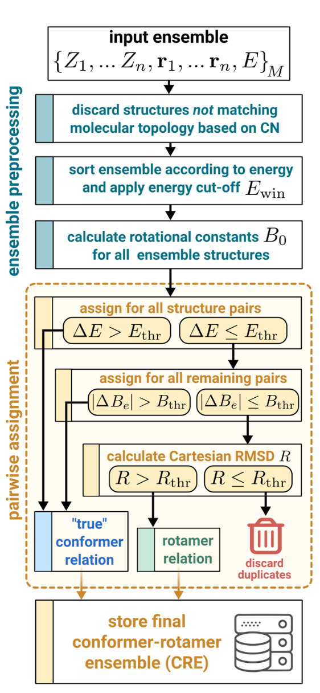
CREGEN
Conformer–Rotamer Ensemble GENeration (CREGEN) is implemented in CREST to aid in the identification of conformers, their associated rotamers, and duplicated structures.

Slide 18
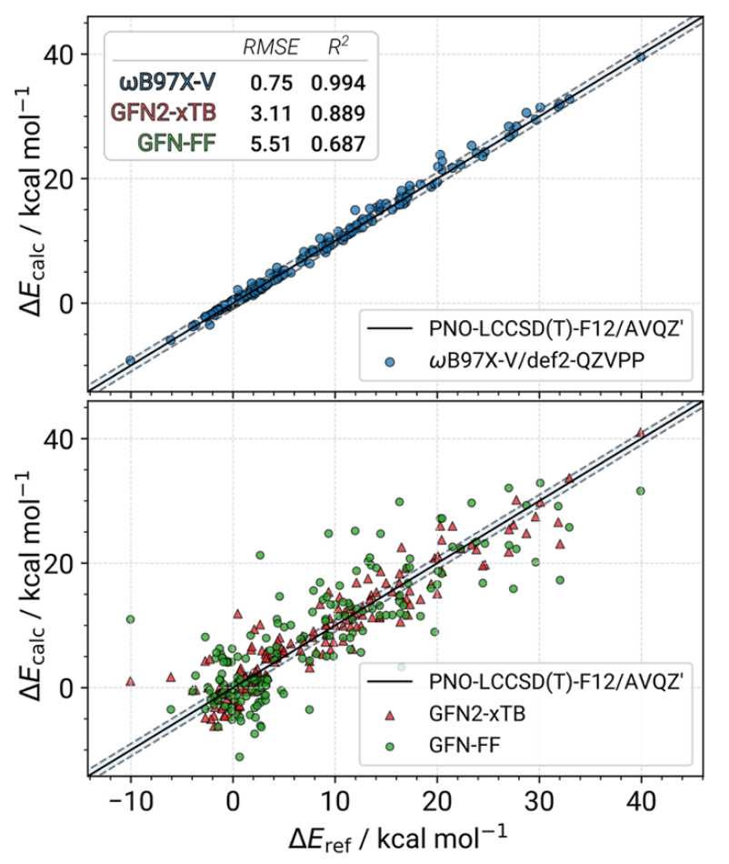
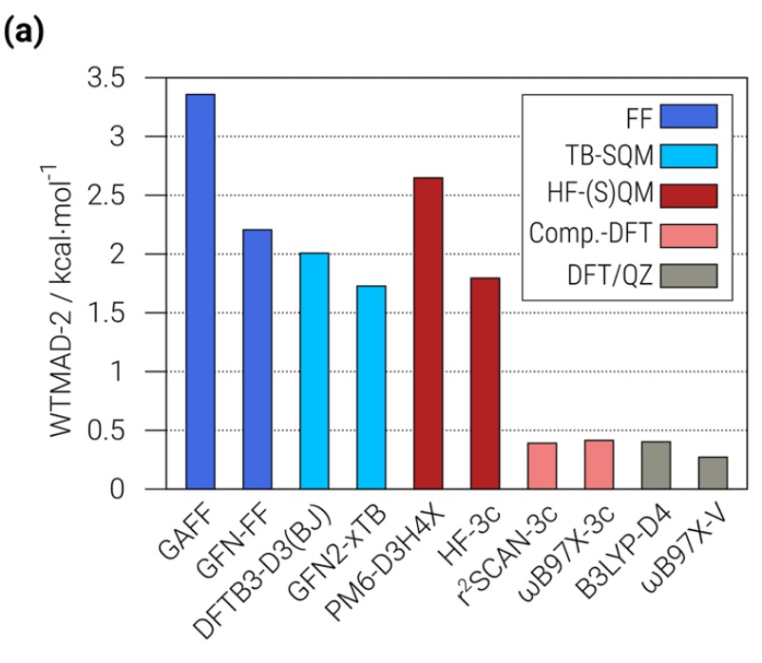
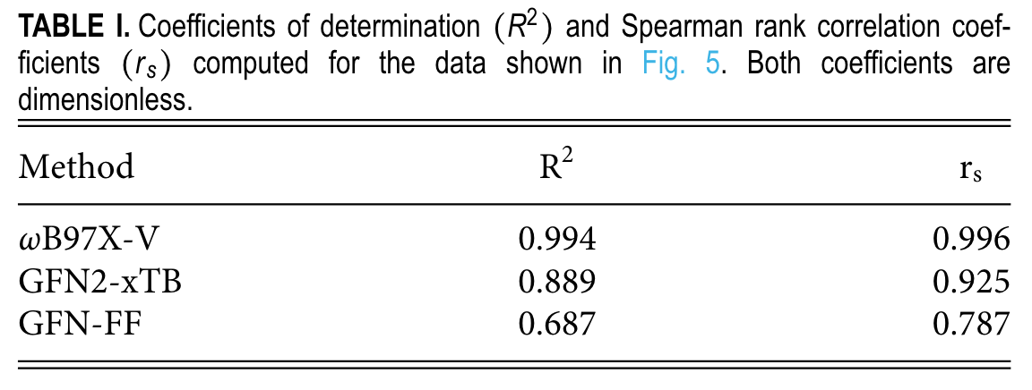
CREST benchmarking
GFN2-xTB
Conformational energies are more accurate than HF-S(QM), and less accurate than composite DFT methods
Much faster, and perform well in correctly ordering the conformers

Slide 19
Constraints and non covalent complexes
an ellipsoidal potential can be used to encapsulate the studied complex and avoid problems due to the metadynamics bias which, by maximization of the RMSD due to increasing the distance between the non-covalently bound fragments, would minimize the energy and hence only generate dissociated clusters. A dedicated non-covalent interaction (NCI) runtype, called NCI-MTD, is implemented in CREST to automatically set up the ellipsoid potential and slightly modify the bias potential parameters.
as opposed to previous program versions, CREST 3 implements the complete freezing of atoms in all metadynamics simulations and geometry optimizations

Slide 20
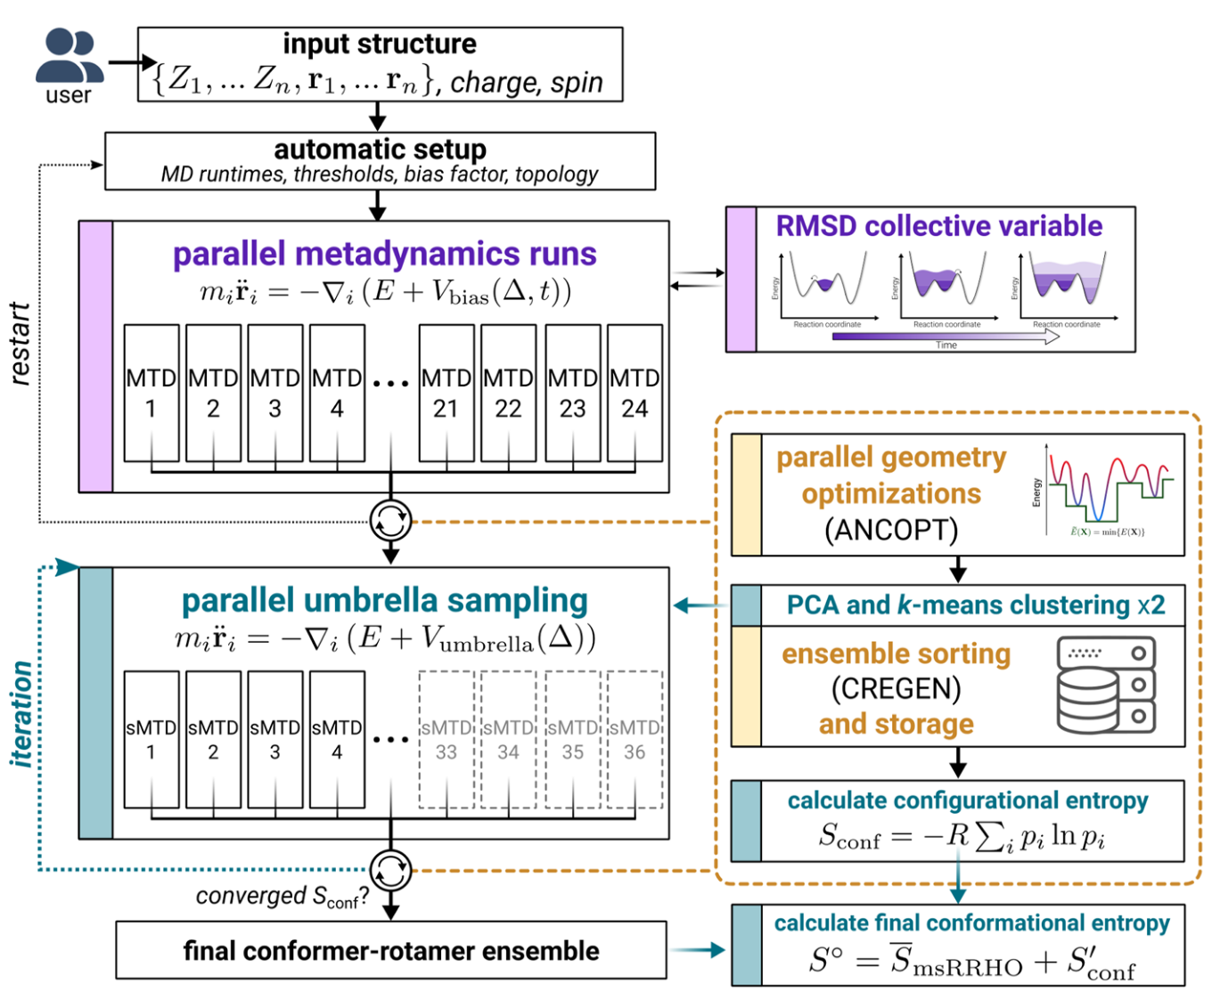
New extension in CREST 3.0
Configurational entropy calculation
Notes:
Outline of the iterative metadynamics–static metadynamics (iMTD-sMTD) workflow used to calculate the configurational entropy.

Slide 21
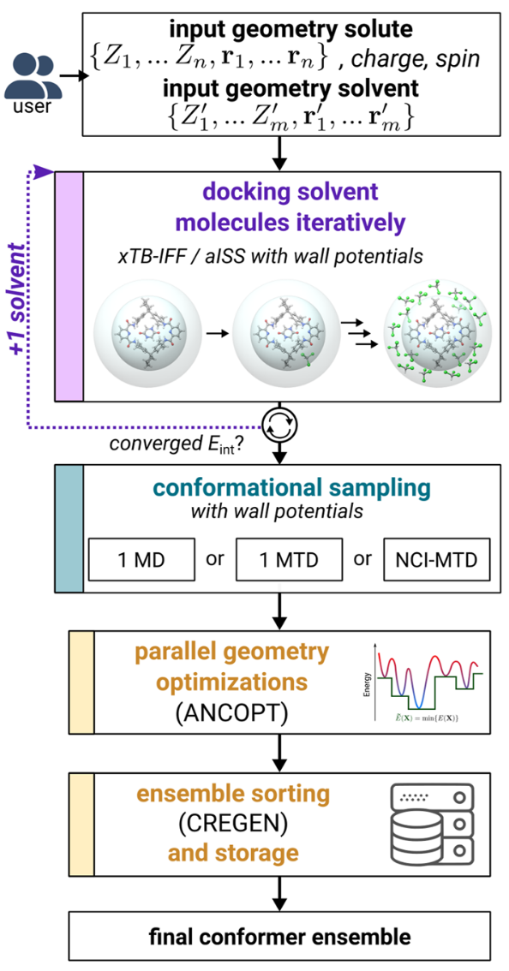
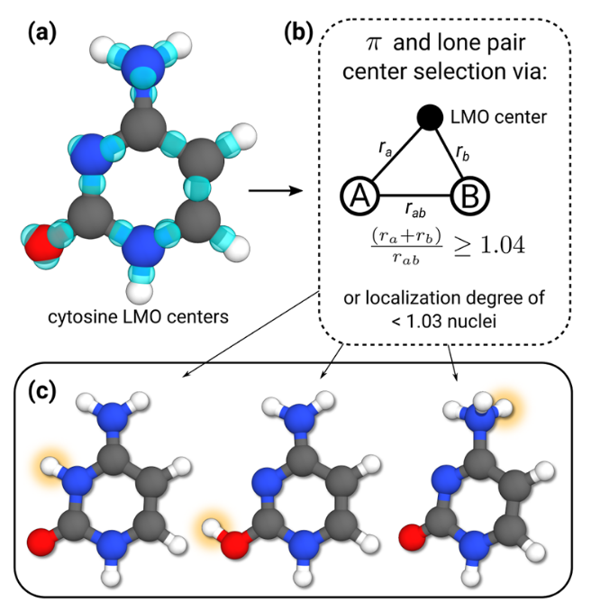
Additional program functions

Slide 22
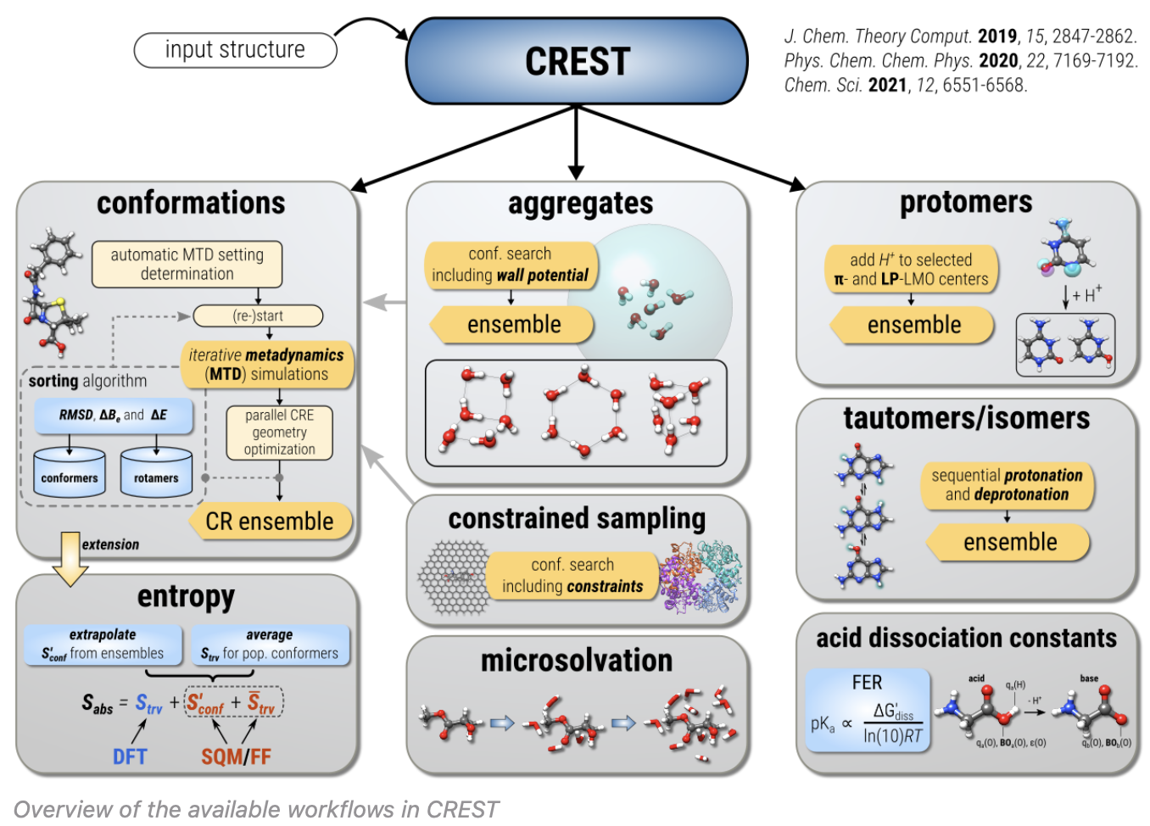

Slide 23
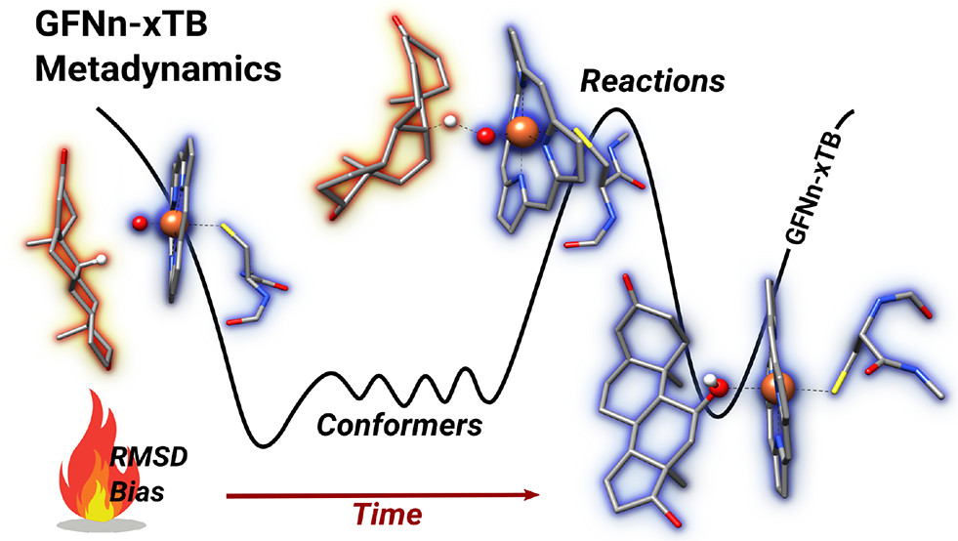
Metadynamics based on tight-binding method: J. Chem. Theory Comput. 2019, 15, 5, 2847–2862
Notes:
Metadynamics based on tight-binding method: J. Chem. Theory Comput. 2019, 15, 5, 2847–2862

Slide 24
How to evaluate conformational analysis?
Are the resulting geometries structurally valid and reasonable?
How comprehensive is the search?
Are the relative energies calculated at low level predictive of the relative energies at higher levels?
Notes:
Kanal, Keith, Hutchinson, Int. J. Quantum Chem. 2018, 118
Ebejer, Morris, Deane, JCIM 2012, 52

Slide 25
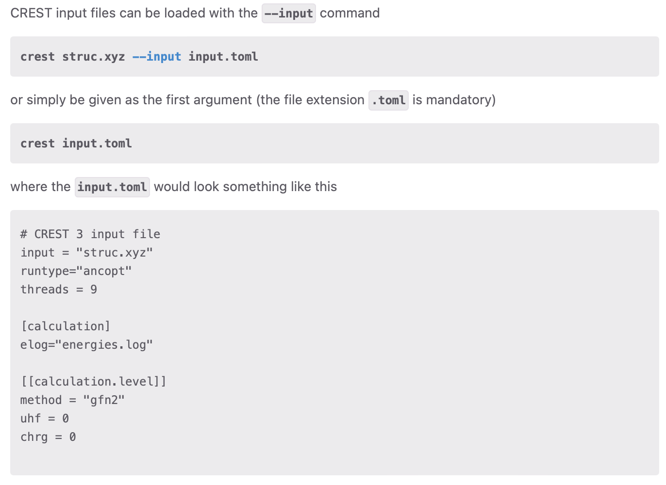
CREST 3.0
TOML config files

Slide 26
Open Babel generate xyz from SMILES
obabel -:"O=C(N)C1=C[N+](CCCC)=CC=C1" -oxyz -O BuNA.xyz --gen3d

Slide 27
xTB
This is the help panel. Below is a list of variables recognised by the script in no specific order:
-i,--input STR coord/file.xyz
-j,--job STR opt/hess/ohess/bhess/scc
-c,--charge INT charge
-u,--unpaired INT number of unpaired electron
-s,--solvent STRING solvent for ALPB
-p,--procs INT processors
-fz,--freeze k,l,m atoms that are to be constrained
-t,--time 00:00:00 wall time for your job. [00:05:00]
-a,--add '...' additional arguments passed to xTB

Slide 28
xTB to optimize structure
XTBHOME=/opt/apps/xtb
export PATH=$XTBHOME:$PATH
export XTBPATH=${XTBHOME}/share/xtb:${XTBHOME}:${HOME}
export PATH=${PATH}:${XTBHOME}/bin
export LD_LIBRARY_PATH=${LD_LIBRARY_PATH}:${XTBHOME}/lib
export PYTHONPATH=${PYTHONPATH}:${XTBHOME}/python
ulimit -s unlimited
export OMP_STACKSIZE=1G
export OMP_NUM_THREADS=8,1
export OMP_MAX_ACTIVE_LEVELS=1
export MKL_NUM_THREADS=8
xtb BuNA.xyz --opt -c 1 -P 8 > xtb.out

Slide 29
Performing a CREST conf search
This is the help panel. Below is a list of variables recognised by the script in no specific order:
-i,--input STR coord/file.xyz
-c,--charge INT charge
-u,--unpaired INT number of unpaired electron
-s,--solvent STRING solvent for ALPB
-p,--procs INT processors
-fz,--freeze k,l,m atoms that are to be constrained
-ewin INT energy window for the conformers
-nci for non-covalent complexes
-noreftopo skip topology check after first xTB run
-protonate protonation protocol
-deprotonate deprotonation protocol
-tautomerize tautomerization protocol
-t,--time 00:00:00 wall time for your job. [01:00:00]
-a,--add '...' additional arguments passed to Crest
crestsetup.sh -i xtbopt.xyz -c 1 -p 8 -noreftopo
You will get a number of outputs from this job, but the one we will be using in this workflow is crest_ensemble.xyz This file contains xyz coordinates for all of the different conformers found using this conformer search.

Slide 30
Looking at ensemble results
In the case of our structure, we have X conformers, too many to realistically perform high-level DFT calculations on, so we have to narrow it down. So we turn to CENSO

Slide 31
Initial Sorting with CREGEN
Overall, we want to use CENSO to reduce the number of conformers that will go on to DFT calculations. However, there are computationally cheaper methods that can remove duplicate structures from the ensembles before we move on to the more advanced calculations. An easy way to remove duplicate structures is using CREGEN, part of CREST's package.
CREGEN does quick calculations to remove duplicate structures. There are a number of keywords that you can use to reduce the number of conformers that you get out at the end. This can include making an energy threshold cut-off, where any structures within a certain number of kcal in energy are considered the same structure. Additional information about the CREGEN keywords can be found in the CREST documentation.

Slide 32
CREGEN
crest BuNA.xyz --cregen crest_conformers.xyz --ewin 6 --ethr 0.1 --bthr 0.1 --rthr 0.125 > cregen_output.txt
This uses BuNA.xyz as a reference structure, then sorts crest_conformers.xyz using keywords --ewin, --ethr, --bthr, and --rthr, then writing the output to a file called cregen_output.txt. The output file that we will use moving forward is crest_conformers.xyz.sorted, which has removed all duplicates based on the keywords that we entered and sorted the conformers by energy.
Now that we have performed a conformer search and done a quick reduction of the number of conformers, we are ready for CENSO.

Slide 33
Next steps
Fast semi-empirical optimizations to get more accurate energies, then resorting with CREGEN

